Slide 1
Experiment 4.
A Carbonate Analysis;
Molar Volume of Carbon Dioxide
Data Summary

Slide 2
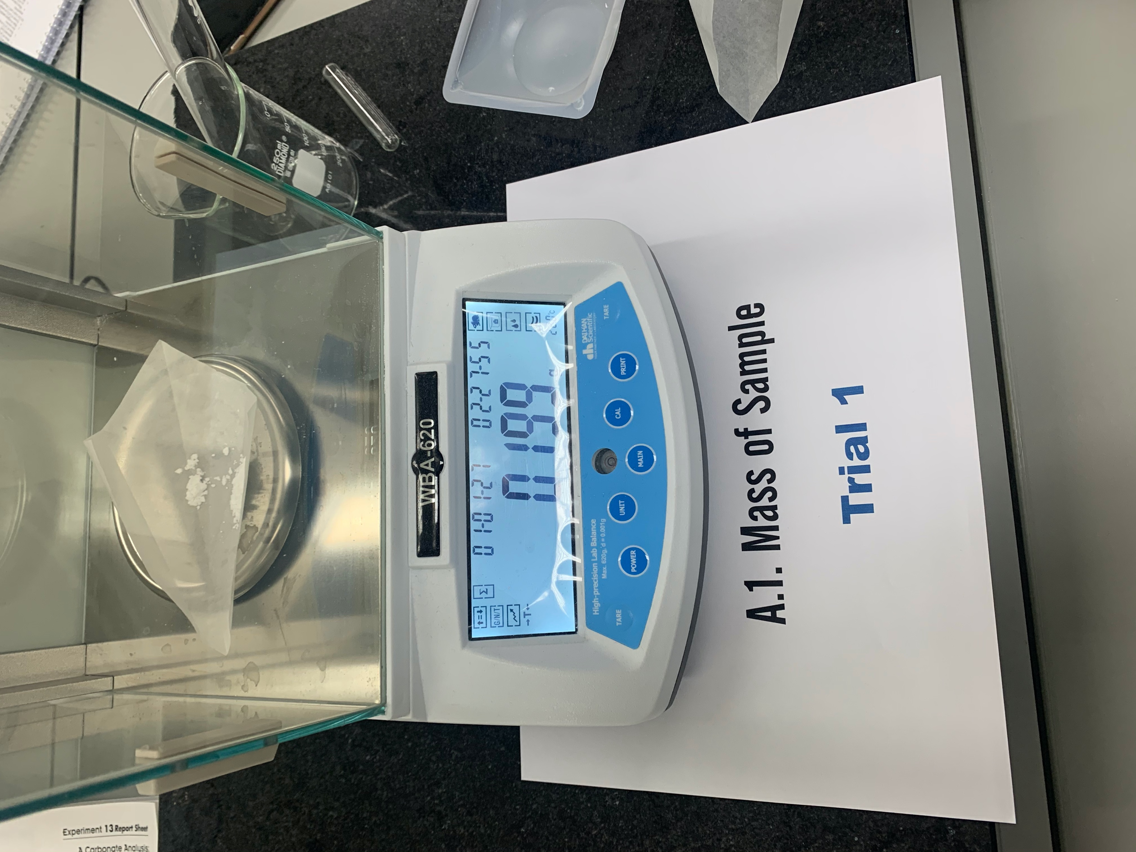
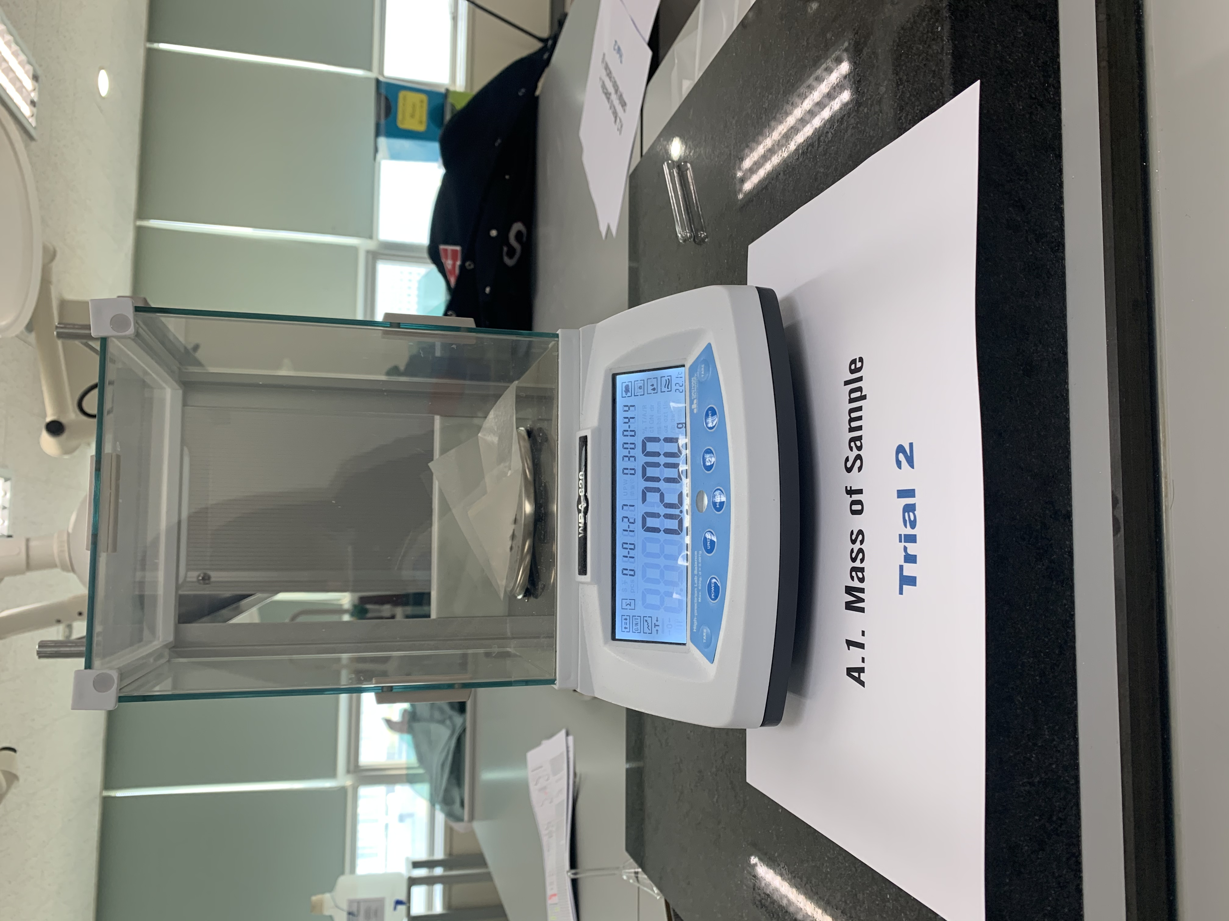
2. Sample preparation
A.1 Mass of heterogeneous sample

Slide 3
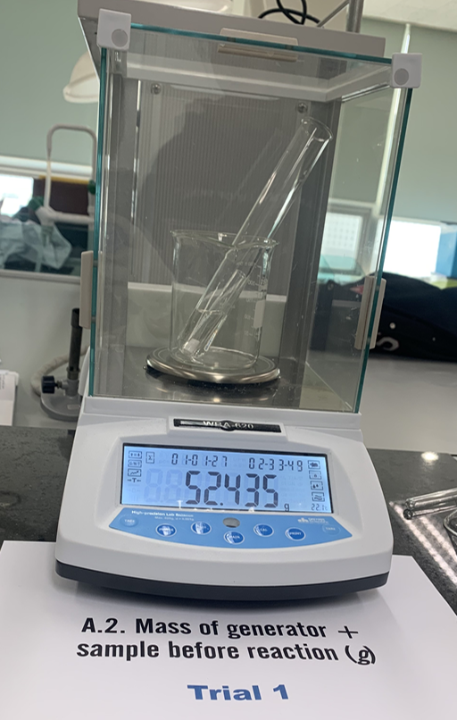
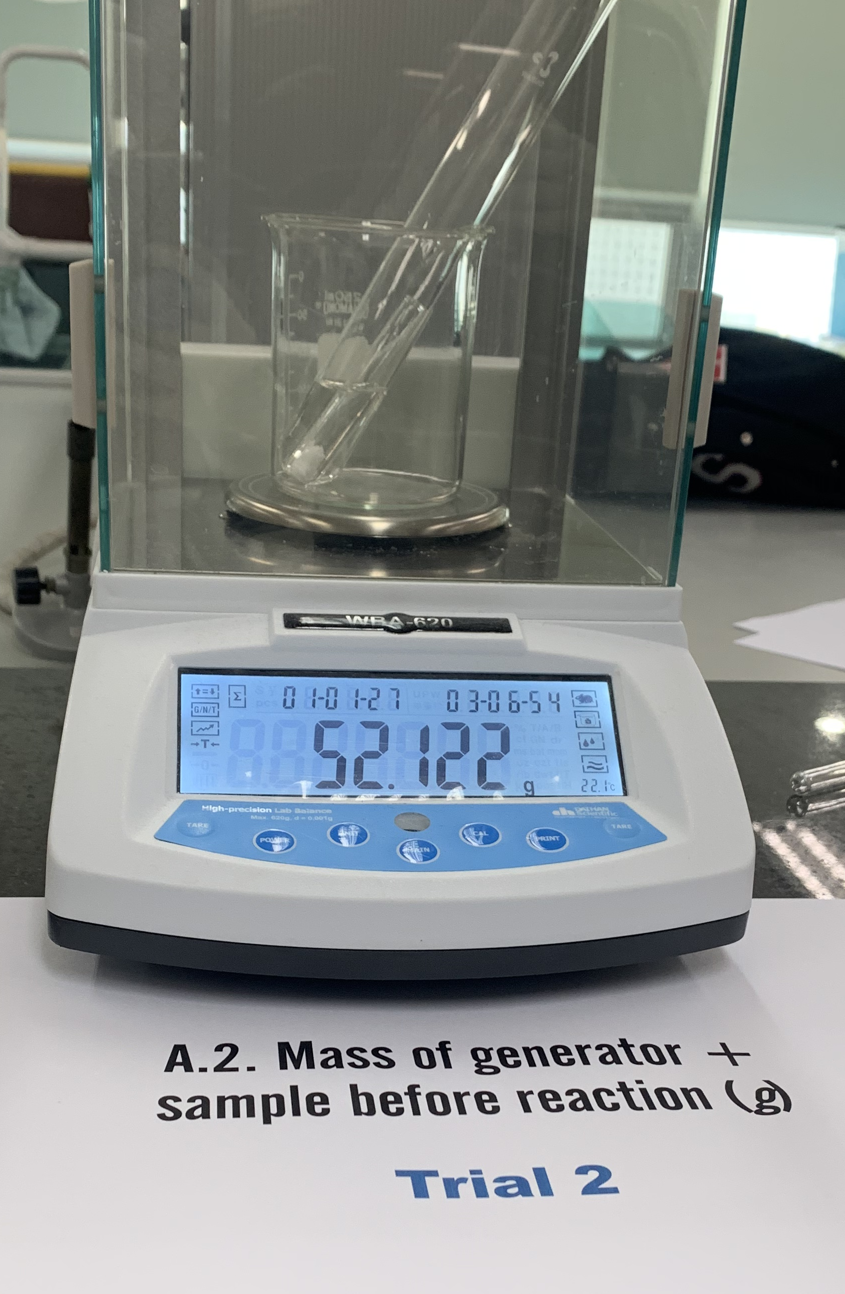
A.2 Mass of CO₂ generator
Measure the combined mass of this CO₂ generator below

Slide 4
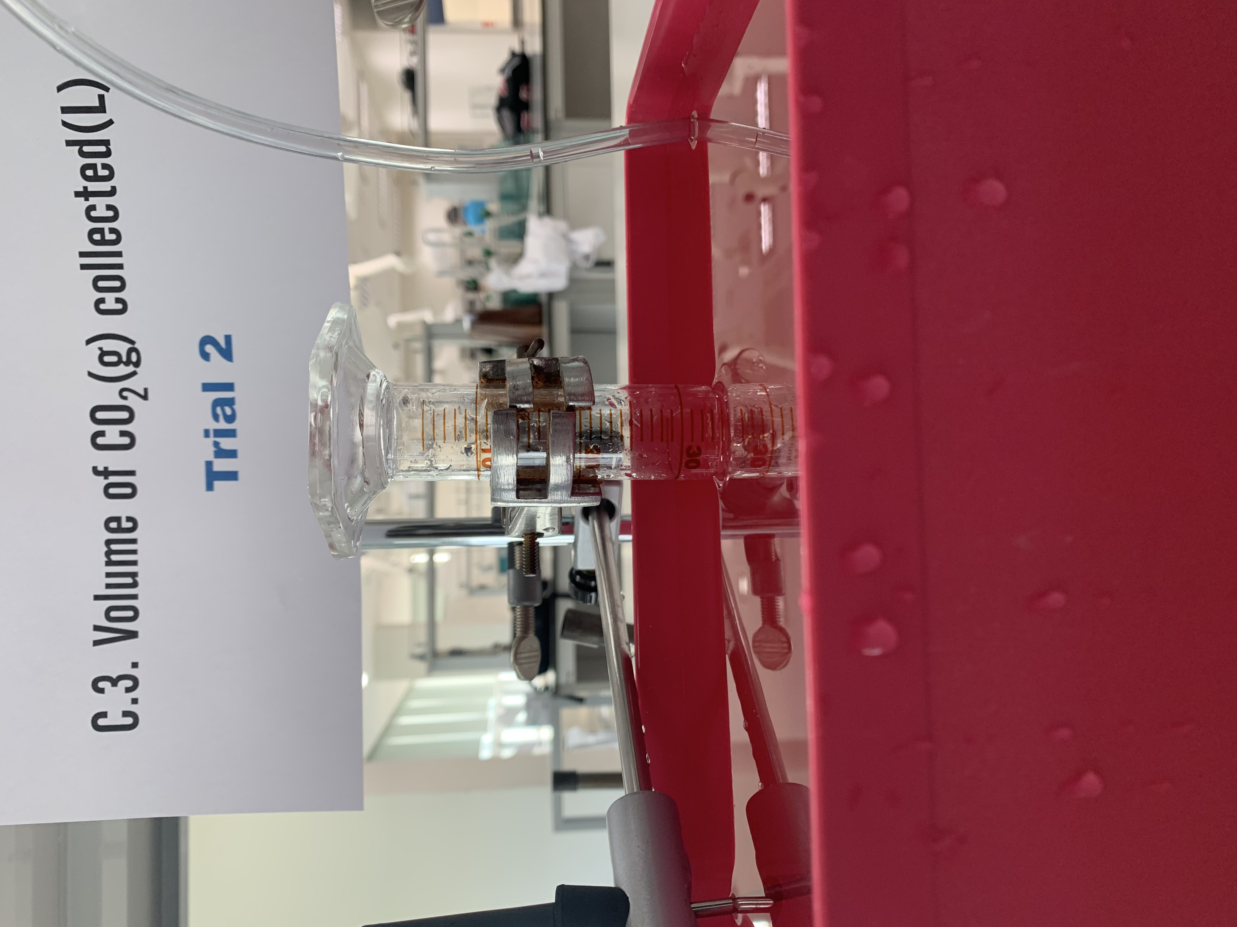
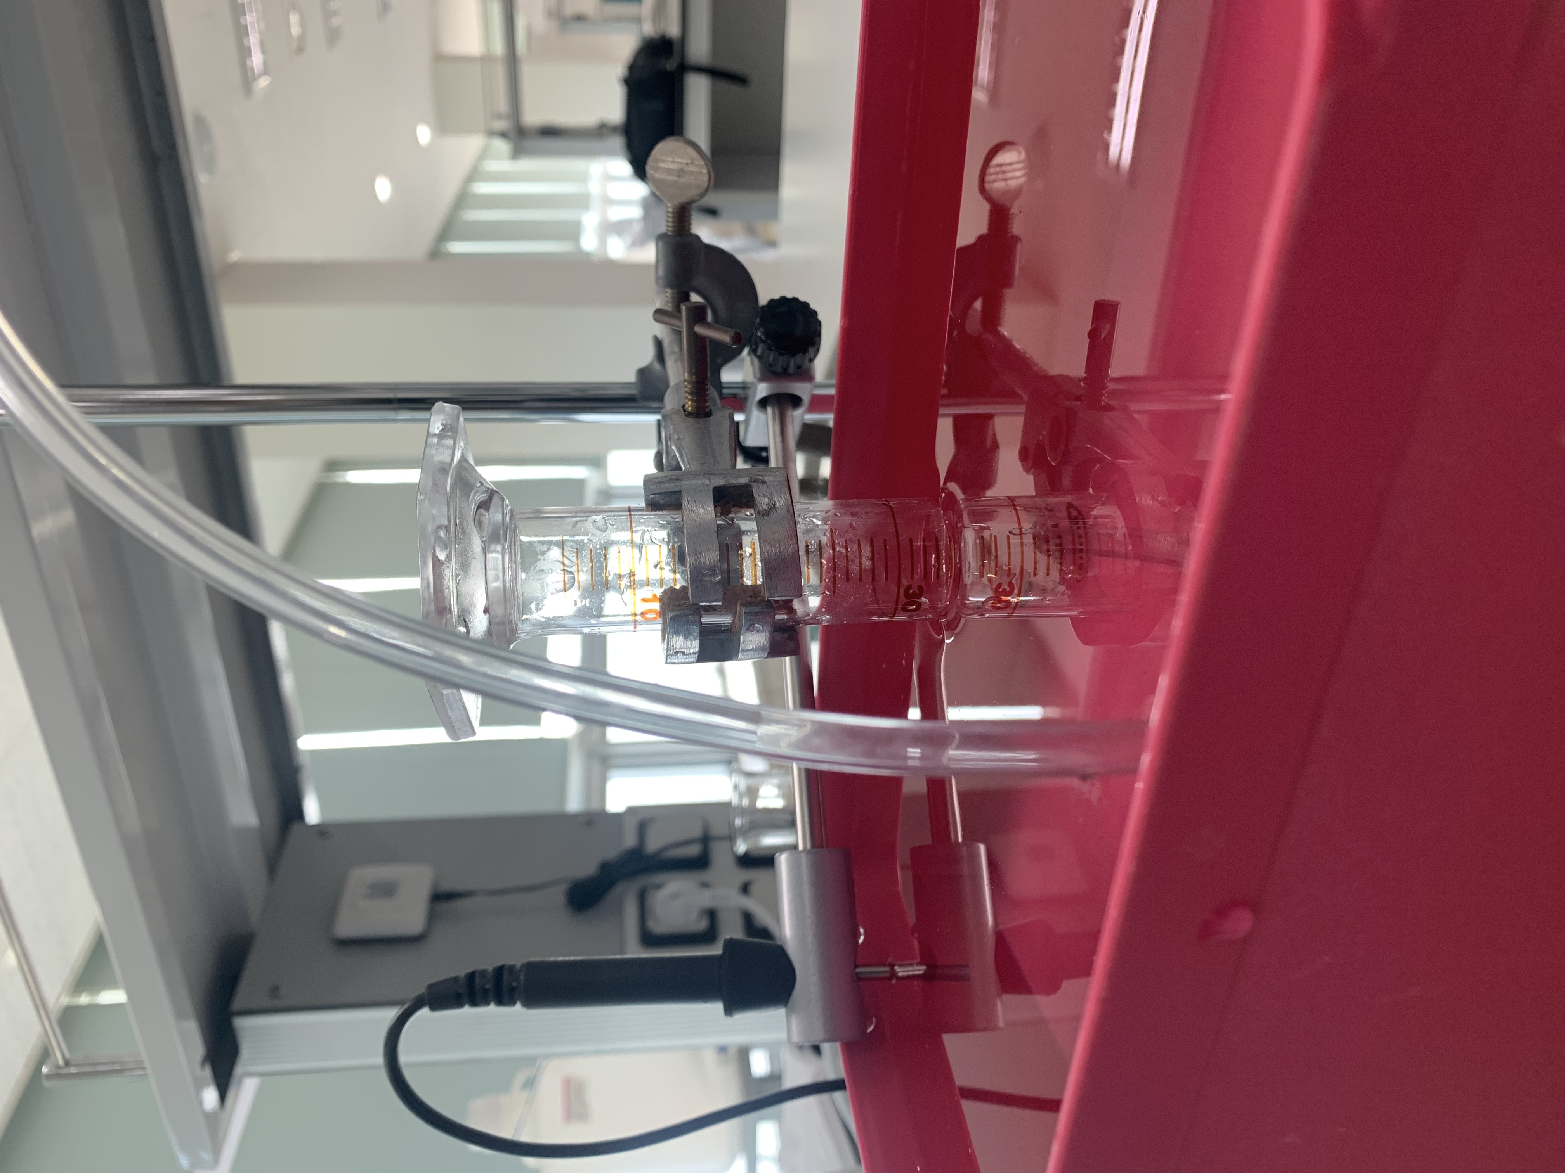
C.3. Volume of CO₂(g) generated, final reading of volume of water
Initial reading of volume of water in CO₂-collecting graduated cylinder (mL)
: 0 mL (both)
C.3. Volume of CO₂(g) collected (L)
Trial 1
34 mL
35 mL

Slide 5
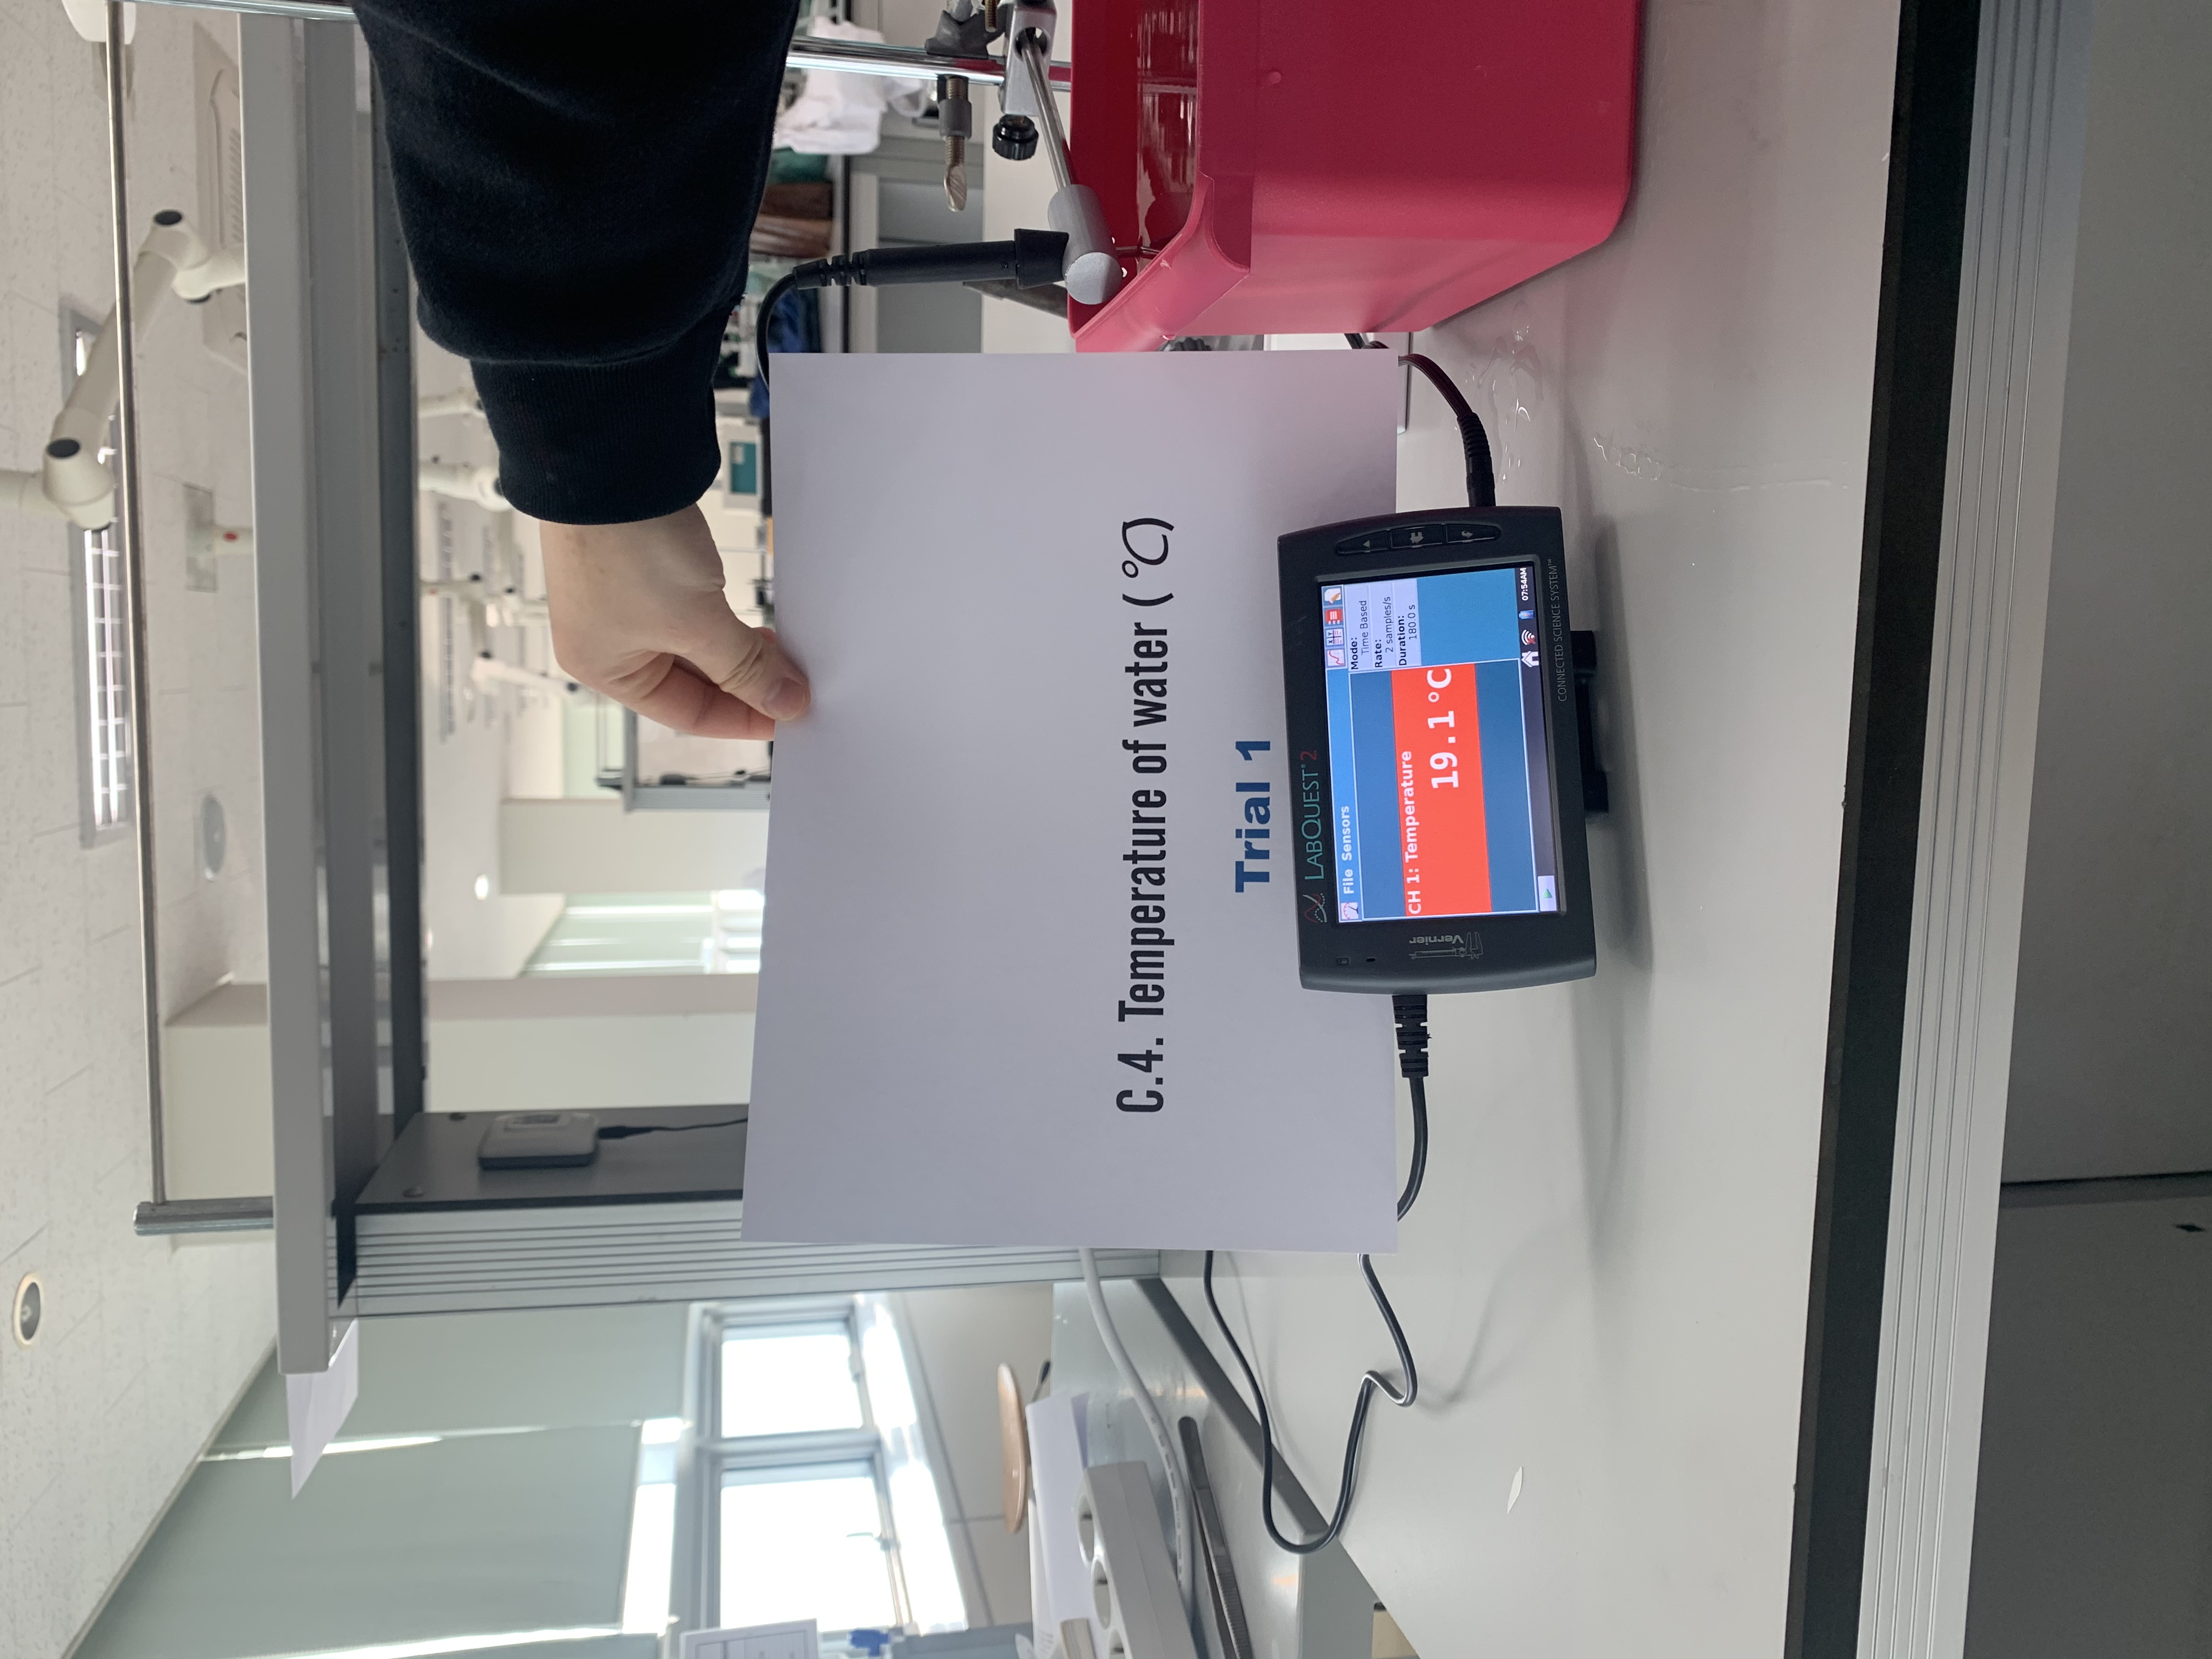
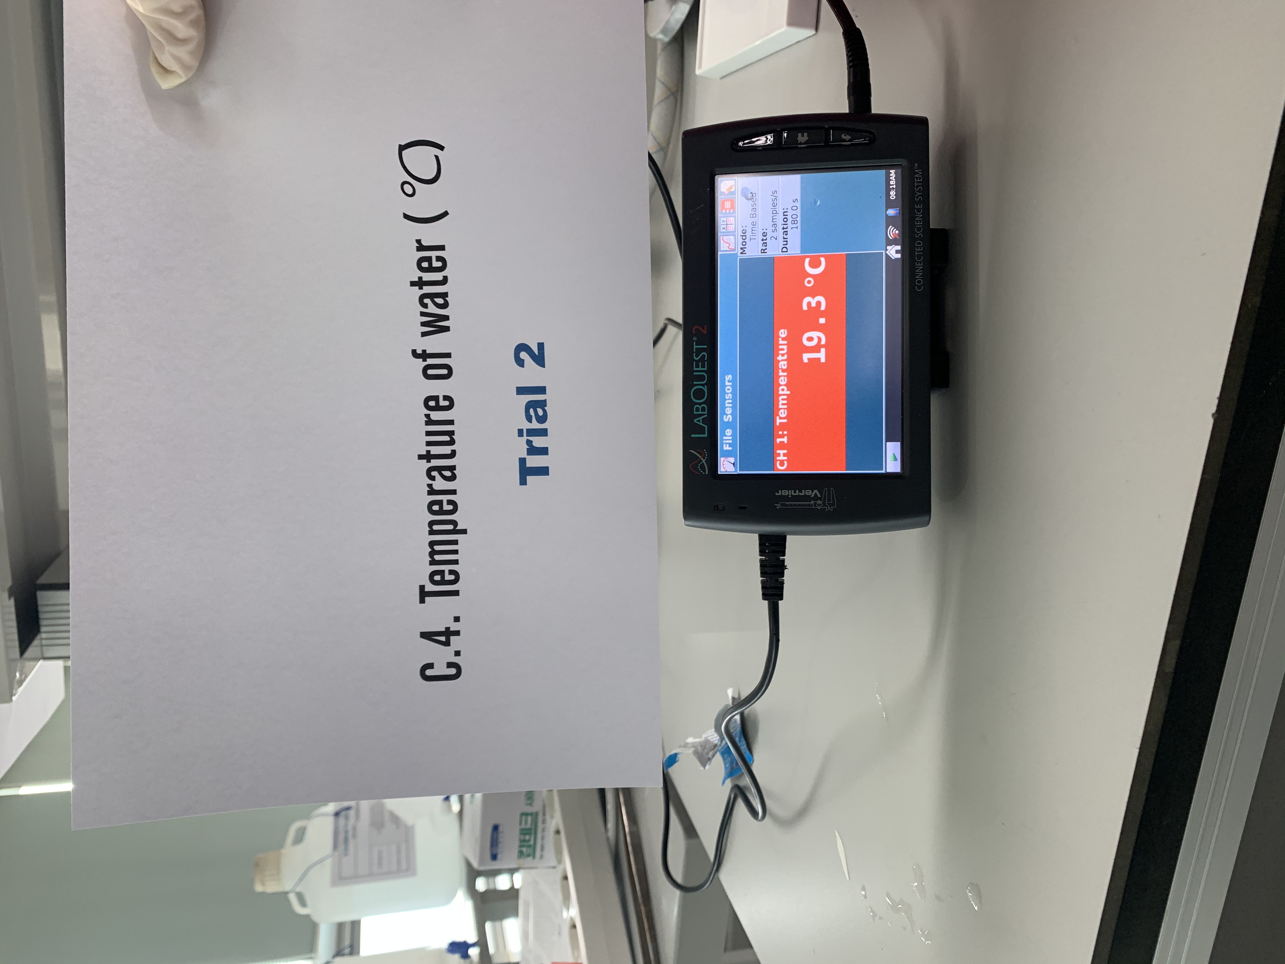
C.4. Determine the temperature of CO₂(g)

Slide 6
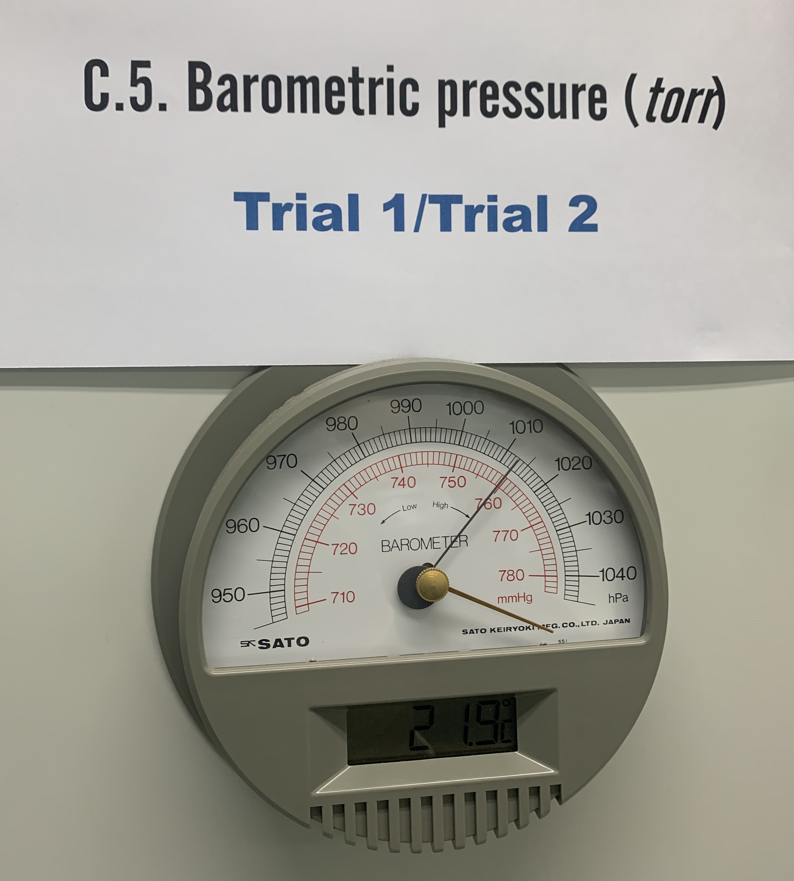
C.5. Determine the pressure of the CO₂(g)
C.6. Vapor pressure of H₂O : Appendix C

Slide 7
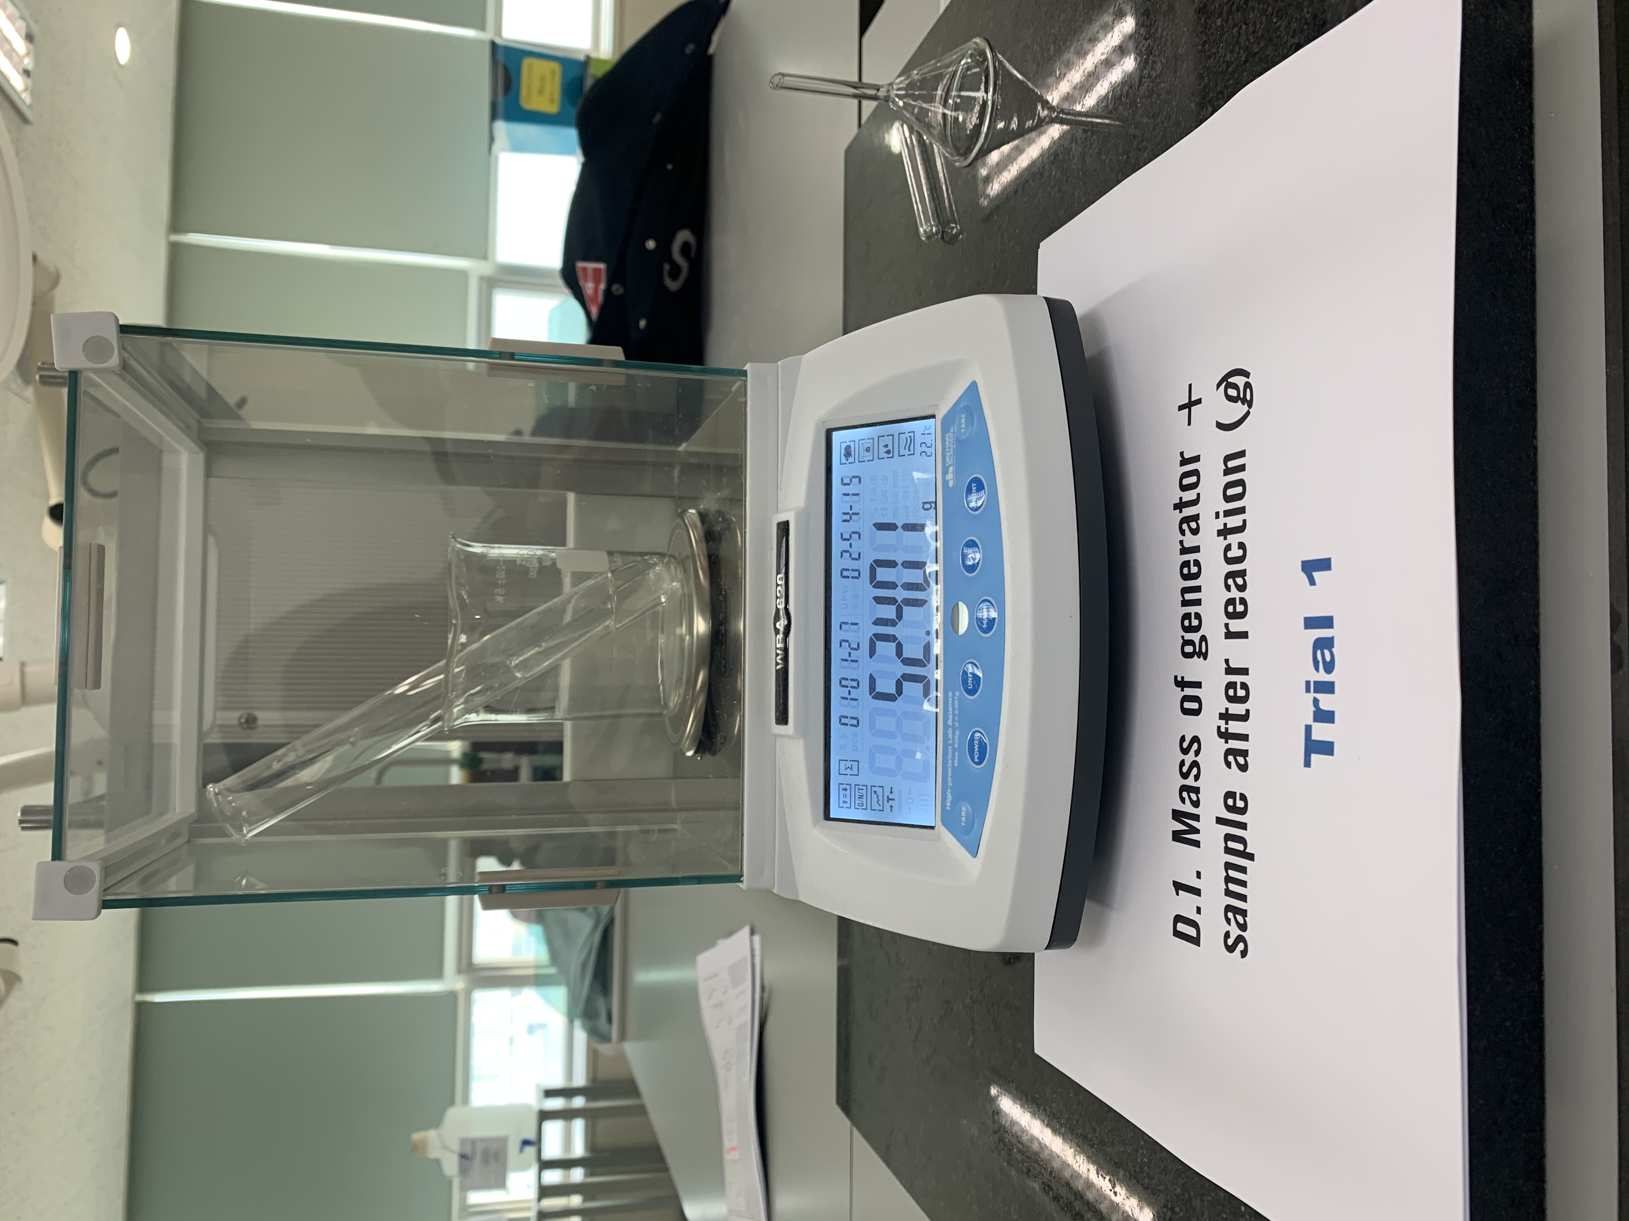
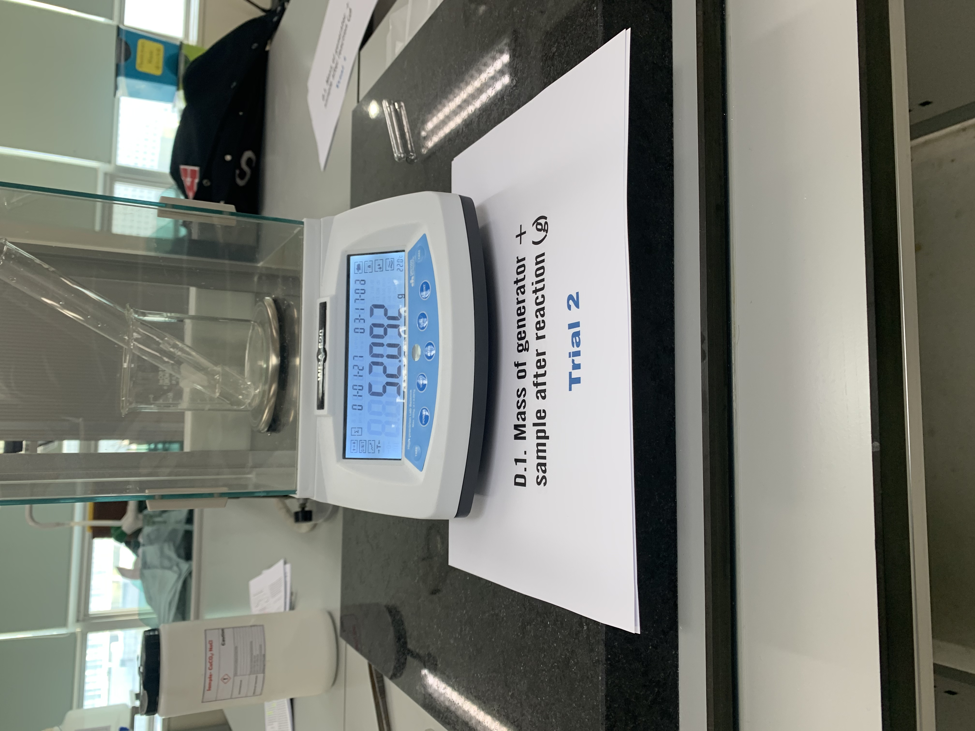
D.1. Mass of generator + sample after reaction(g)

Slide 8
Report Sheet

Slide 9
Report Sheet
Sample Preparation and Setup Apparatus
Calculation of mass of CaCO₃ sample for analysis ([rom Prelaboratory Assignment, question 2(a)]
 | Trial 1 | Trial 2
1. Mass of sample (g) | ( ) | ( )
2. Mass of generator + sample before reaction (g) | ( ) | ( )
3. Instructor’s approval of apparatus
C. Determination of Volume, Temperature, and Pressure of the Carbon Dioxide Gas
 | Trial 1 | Trial 2
1. Initial reading of volume of water in CO₂-collecting graduated cylinder (mL) | ( ) | ( )
2. Final reading of volume of water in CO₂-collecting graduated cylinder (mL) | ( ) | ( )
3. Volume of CO₂(g) collected (L) | ( ) | ( )
4. Temperature of water (ºC) | ( ) | ( )
5. Barometric pressure (torr) | ( )
6. Vapor pressure of H₂O at ( ) ºC (torr) | ( ) | ( )
7. Pressure of dry CO₂(g) (torr) | ( ) | ( )

Slide 10
D. Amount of Carbone Dioxide Gas Evolved
 | Trial 1 | Trial 2
1. Mass of generator + sample after reaction (g) | ( ) | ( )
2. Mass loss of generator = mass CO₂ evolved (g) | ( ) | ( )
3. Moles of CO₂(g) evolved (mol) | ( ) | ( )
E. Molar Volume of CO₂ Gas
 | Trial 1 | Trial 2
1. Pressure of dry CO₂ (g) (atm). | ( ) | ( )
2. Volume of CO₂(g) at STP (L) | ( ) | ( )
3. Molar volume of CO₂(g) at STP (L/mol). | ( ) | ( )
4. Average molar volume of CO₂(g) at STP (L/mol) | ( )

Slide 11
F. Percent CaCO₃ in Mixture
 | Trial 1 | Trial 2
1. Moles of CaCO₃ in sample from mol CO₂ generated (mol). See equation 13.1. | ( ) | ( )
2. Mass of CaCO₃ in sample (g) | ( ) | ( )
3. Mass of original sample (g) | ( ) | ( )
4. Percent of CaCO₃ in sample (%) | ( ) | ( )
5. Average percent of CaCO3 in sample (%) | ( )

